Slide 1
Dishcovery
Your cultural culinary companion
Defne Genç, Sharon Wambu,
Abena Ofosu, Kayla Kelly

Slide 2
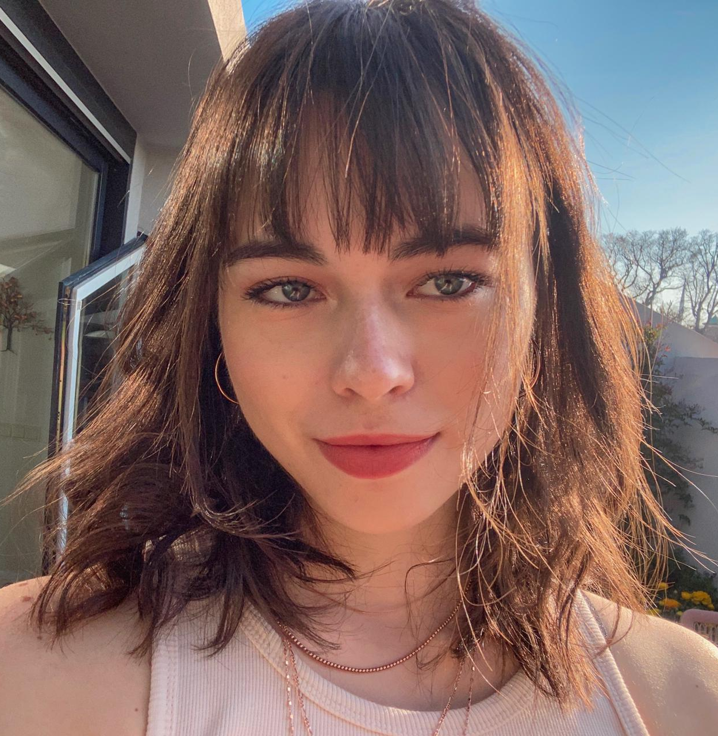
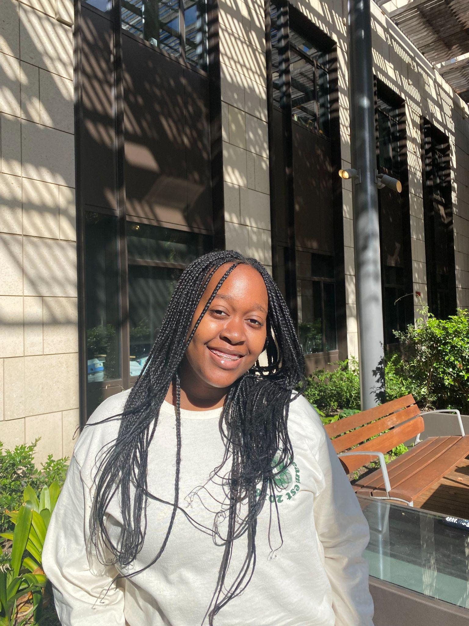

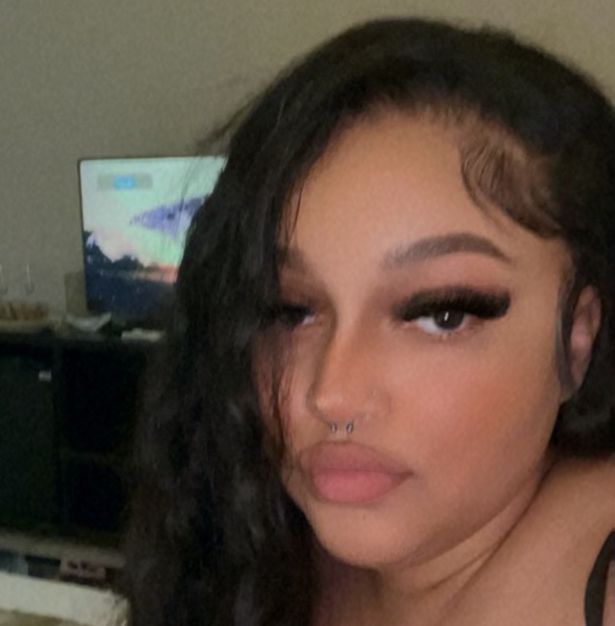
Meet Our Dishcover-ers
Defne
Sharon
Abena
Kayla
Dish of choice:
Dish of choice:
Dish of choice:
Dish of choice:

Slide 3
Problem Statement
Learning about and creating food with ingredients from other cultures can be an intimidating experience.

Slide 4
Our Solution
Dishcovery helps you recognize, learn about, and cook with foods from around the world.

Slide 5
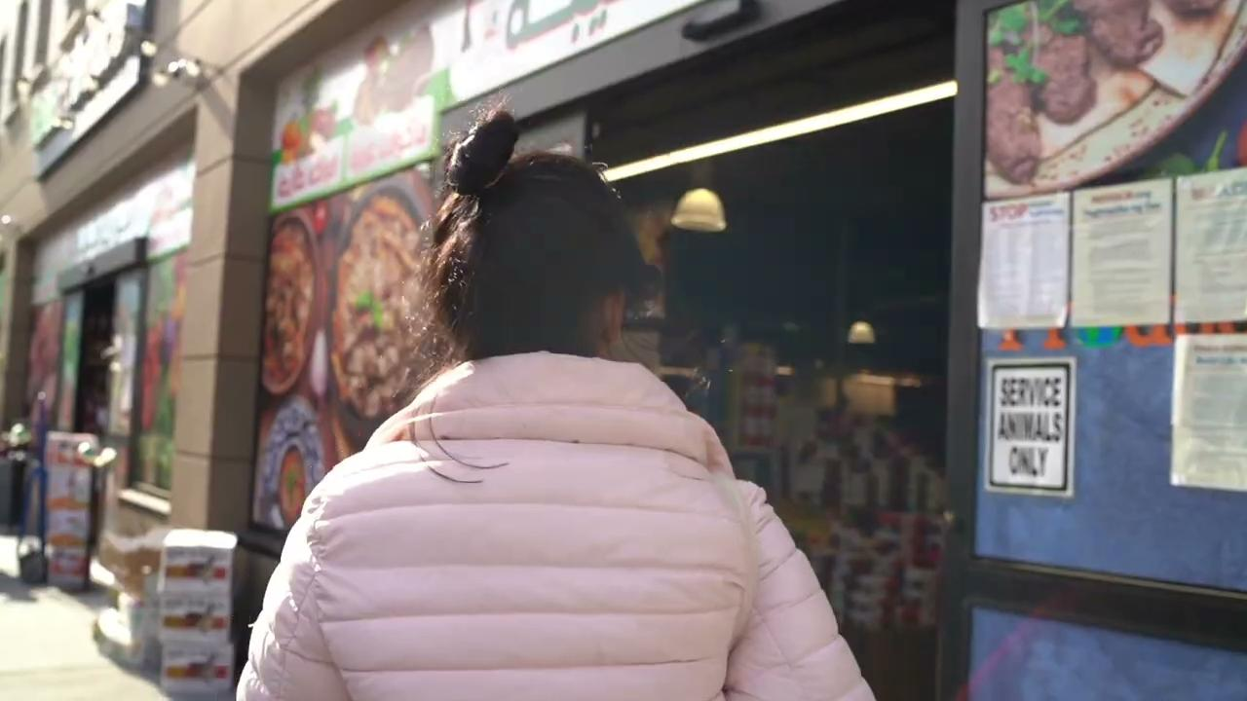
Why Dishcover? (Concept video)

Slide 6
Outline of Presentation
Needfinding, sketching, heuristic evaluations.
Design Evolution
Usability goals, tasks, values, and brand.
UI Description
Overview of V1 implementation.
UI Demo
What’s to come!
Moving Forward

Slide 7

Needfinding
Narrowing the scope of our product

Slide 8
Interviewing
We interviewed:
Martin 30’s, no strong cultural ties, not particularly “food-motivated”
Grace Immigrant from Taiwan and store-owner of Asian grocery store
Jaclyn Immigrant from Peru and head-chef of Comida Peruana
Sofia Immigrant from Mexico, Chef at Xanadu House at Stanford
Amy Server at Decadence at Stanford
Jeson Immigrant from Malaysia, Founder of OpenChefs (cultural food delivery option)

Slide 9
What we observed
Recurring themes that we saw through our initial interviews were:
The overarching value given to authenticity in cooking.
Differences in outlook amongst potential users ranging from seeing cooking as transactional to deeply personal.
Deep sense of pride in certain individuals in cooking their own cultural cuisine.
A general hesitation of interviewees towards cooking foods from other cuisines.

Slide 10
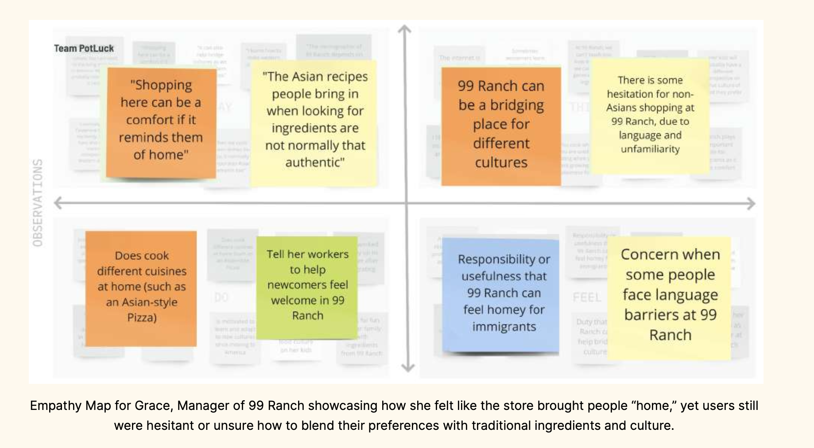
What we observed

Slide 11
POVs & HMWs - Grace
We met…
Grace, the manager of 99 Ranch in Mountain View, who cooks at home and observes customers who are looking for ingredients for Asian cooking. We were surprised to realize that... ● She noticed a lot of people didn’t bring in authentic recipes when looking for ingredients, instead defaulting to westernized versions of traditional Asian foods. We wonder if this means... ● She was concerned that a lot of authenticity behind food was lost through language barriers or inauthentic recipes.
It would be game-changing to...
● Connect people exploring new cuisines to authentic recipes or expert sources of information.

Slide 12
POVs & HMWs
HMW statements we generated included:
● “How might we make it easier to find authentic recipes?”
● “How might we make grocery stores more informative to people unfamiliar with the types of cuisines offered?”
● “How might we create a measure of authenticity for recipes?”

Slide 13
POVs & HMWs
“How might we make unfamiliar ingredients speak for themselves?”

Slide 14
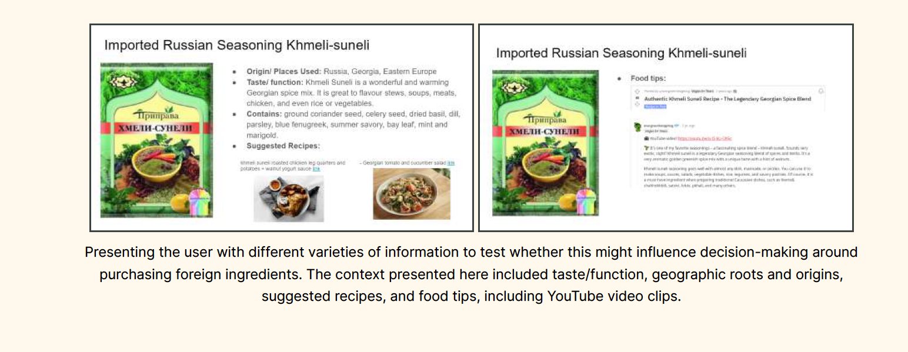
Experience prototypes

Slide 15
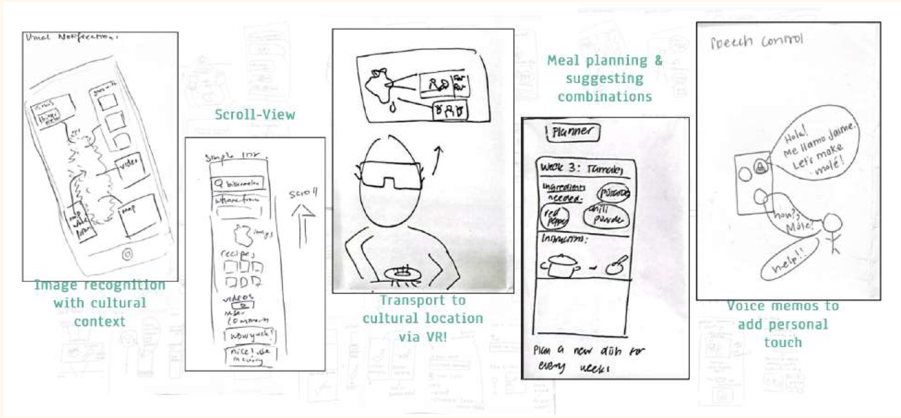
Solution Generation

Slide 16
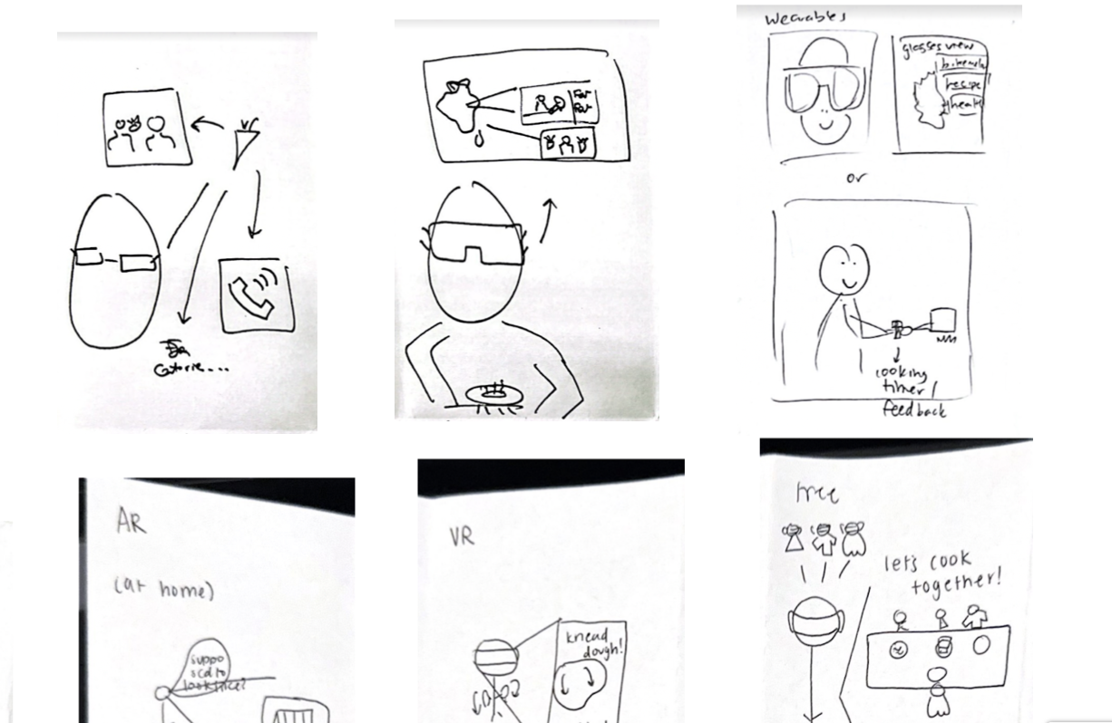
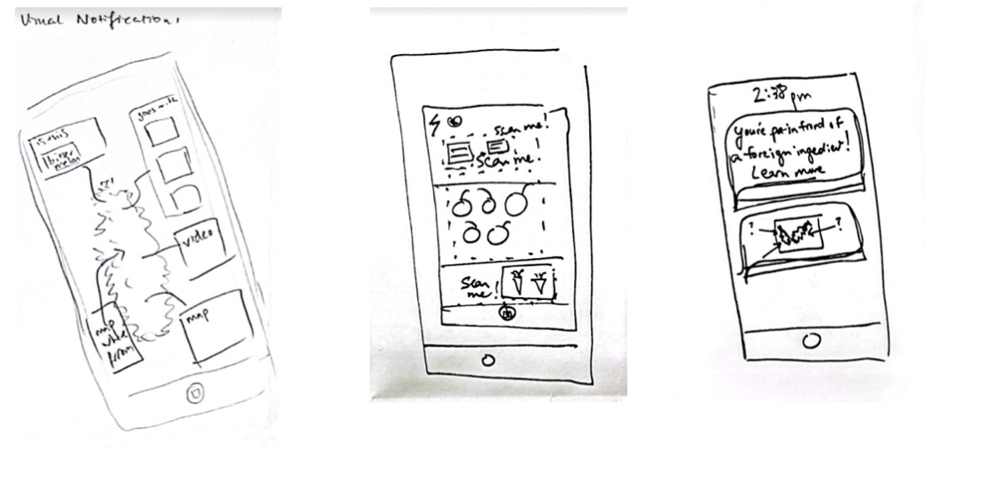
Solution Generation
Option 1: AR Cooking
Option 2: Image Recognition
Scan pantry and see finished dish with instructions.
Scan ingredient and receive information + recipe.

Slide 17
Solution Generation: Pros/Cons
Image Recognition
Augmented Reality
Pros:
Fits into the cultural companion narrative
Variety of information easily available
Really clear connection to our original tasks
No additional hardware
Pros:
Novel software/product
Lots of visual aid while cooking
Documenting what user has cooked/wants to cook
Cons:
Accuracy is imperative and might take lots of training data
Navigating bias toward more common foods
Sourcing accurate data
Visual focus might not be as accessible for visually impaired users
Cons:
Implementation much more difficult
Requires additional hardware
High-effort and potentially not intuitive to users

Slide 18
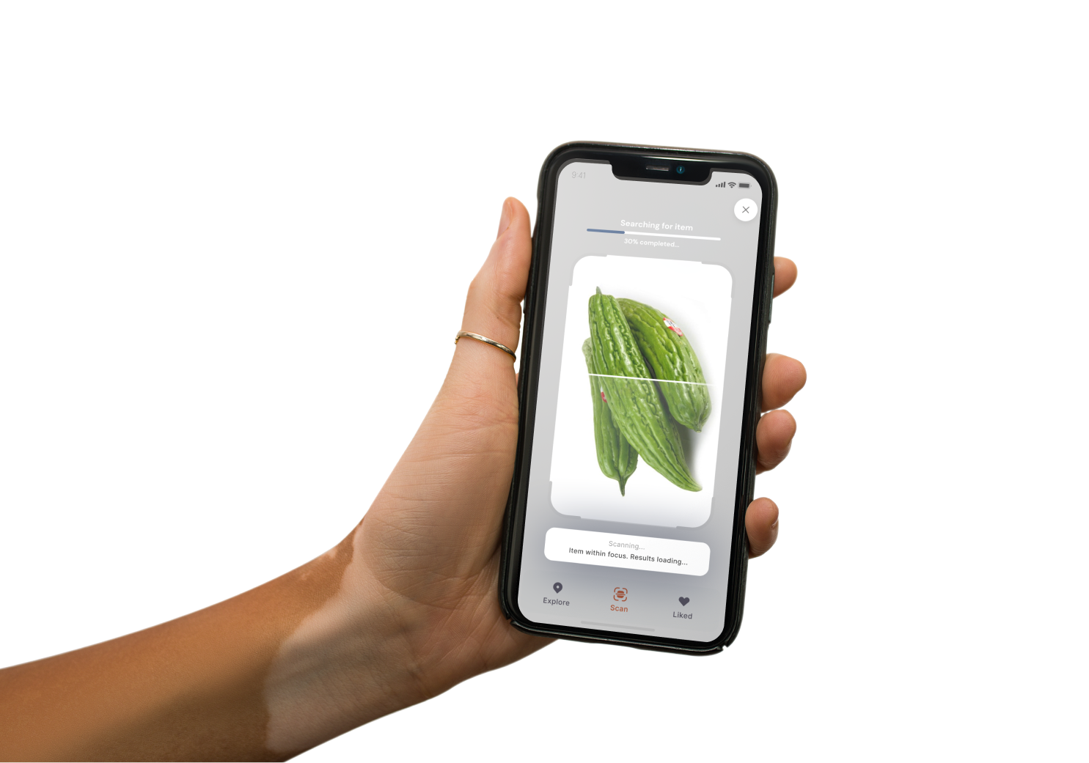
Selected Solution
Image recognition! Now on to…

Slide 19
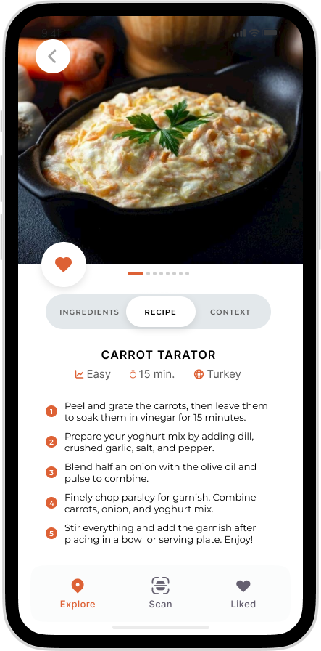
Design
Giving a face to the name

Slide 20
Recap of our Task Flows
1
Search
For an unfamiliar food item through scanning.
2
Contextualise
Using the information provided in the app.
3
Authentic Cooking
Through recipes the user finds and/or saves.

Slide 21
Recap of major design changes
After our heuristic evaluation, Dishcovery’s redesign included:
Removal of gradients + switching to a single accent colour
Rationale: Improved contrast and readability, more emphasis on accent colour
Improved consistency & usability
Rationale: Font size, buttons, and navigation bar needed to be standardised and confirmation steps added to offer a better and more cohesive user experience.
Responsive components
Rationale: Adding the ability to make text expand + collapse or to switch between text makes good use of space and makes the abundance of information in the app more intuitive.

Slide 22
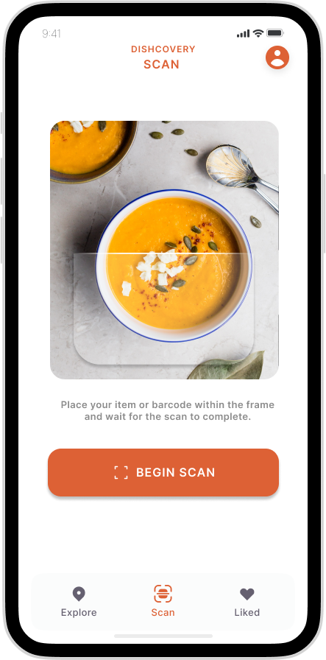
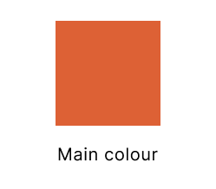
Branding & Values
We want our app to feel:
Approachable
Appetising
Exciting
Welcoming
For this, we opted for:
Soft shadows
Simple colour scheme
Rounded corners
Vibrant visuals

Slide 23
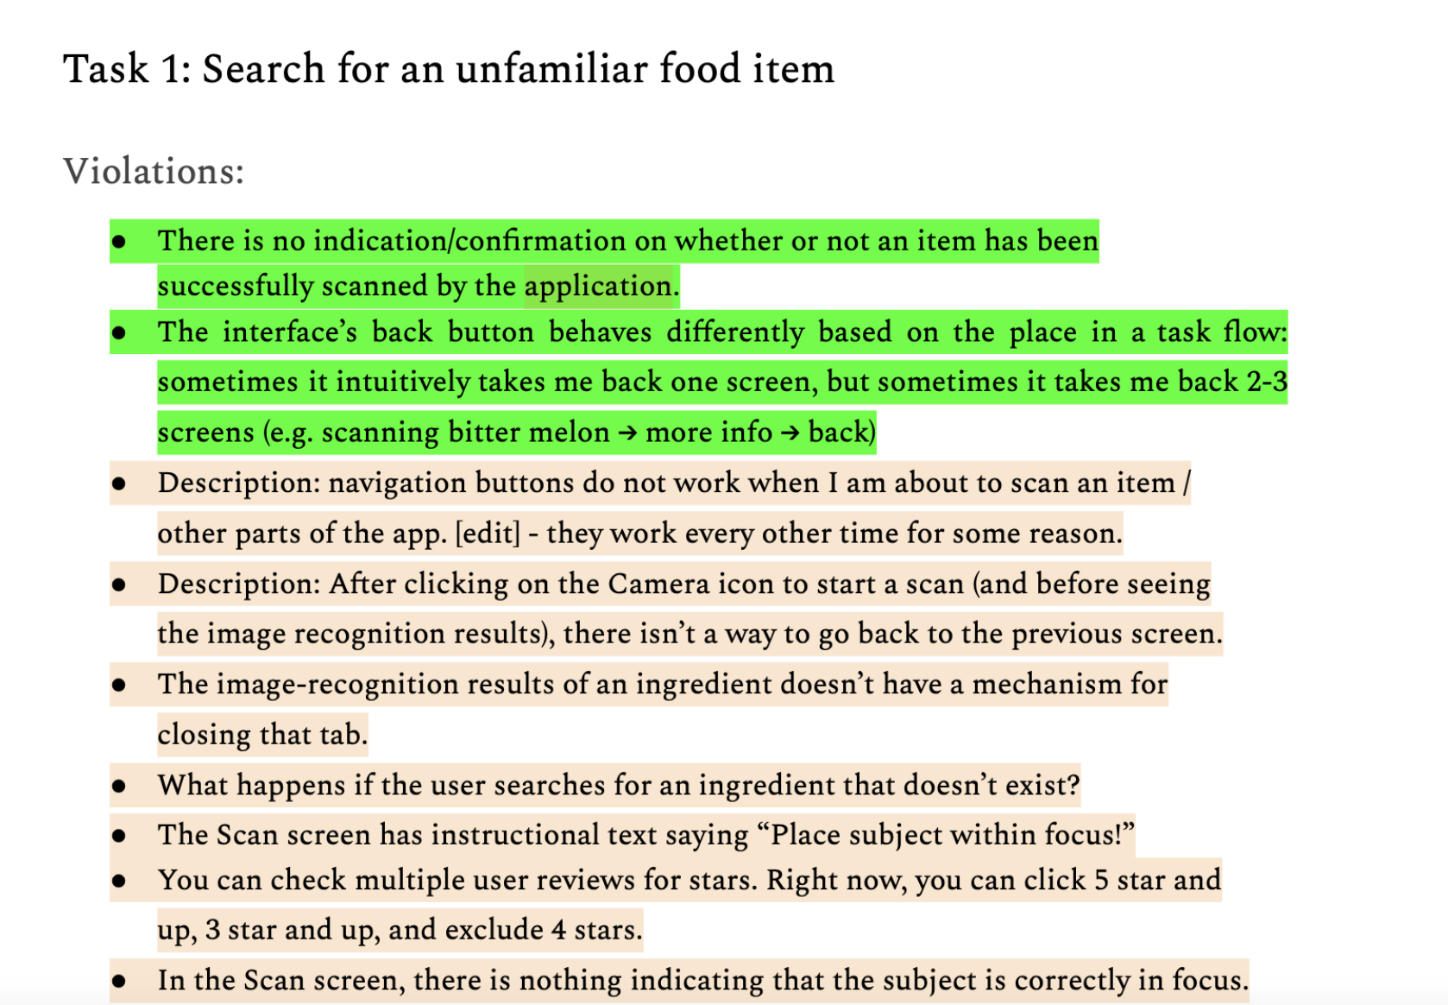
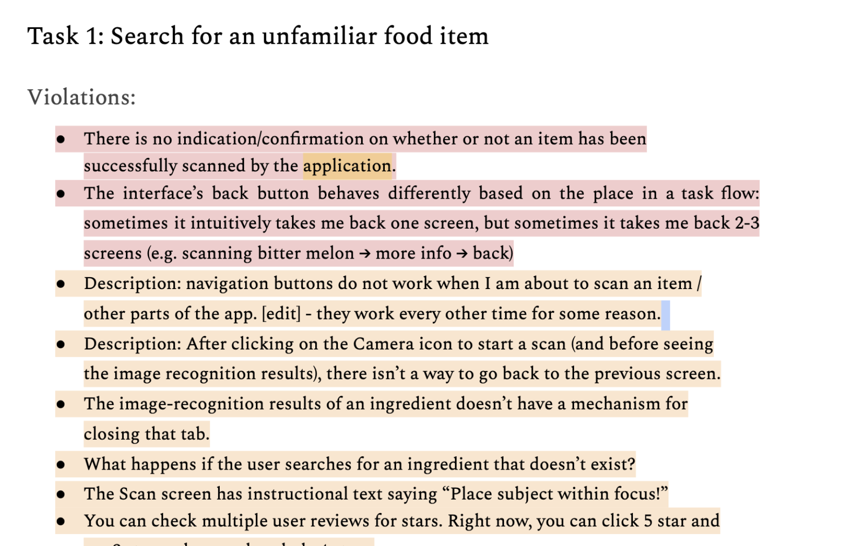
How we redesigned
Red: Severity=4, Orange:Severity=3

Slide 24
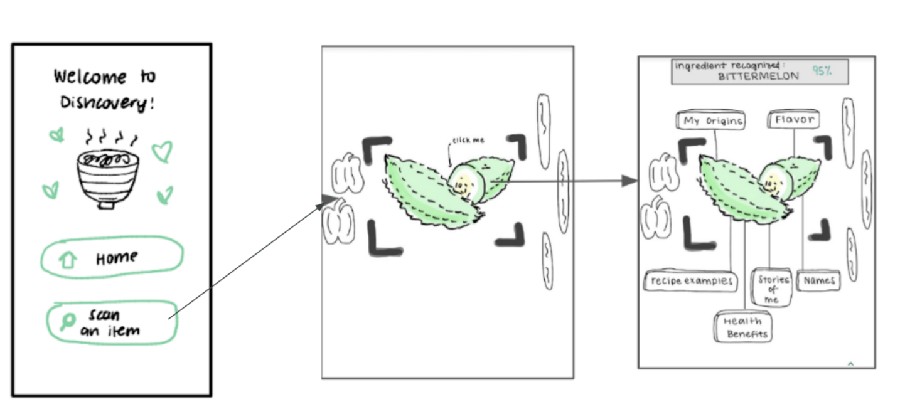
Task 1: Search for an unfamiliar food item (Low-Fi)

Slide 25
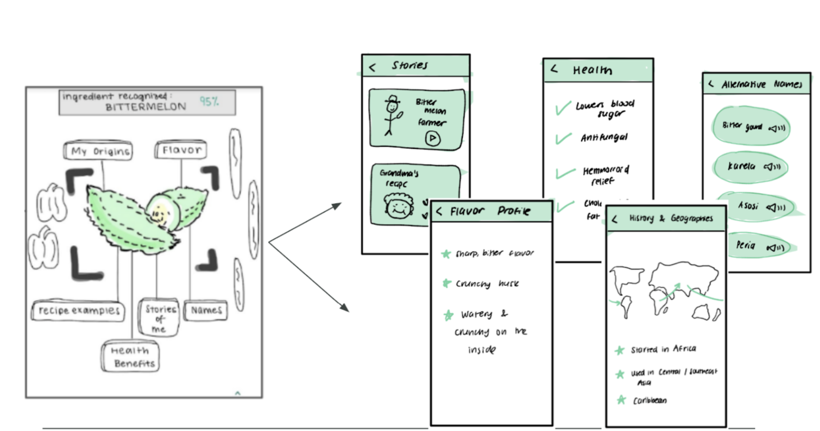
Task 2: Contextualization (Low-Fi)

Slide 26
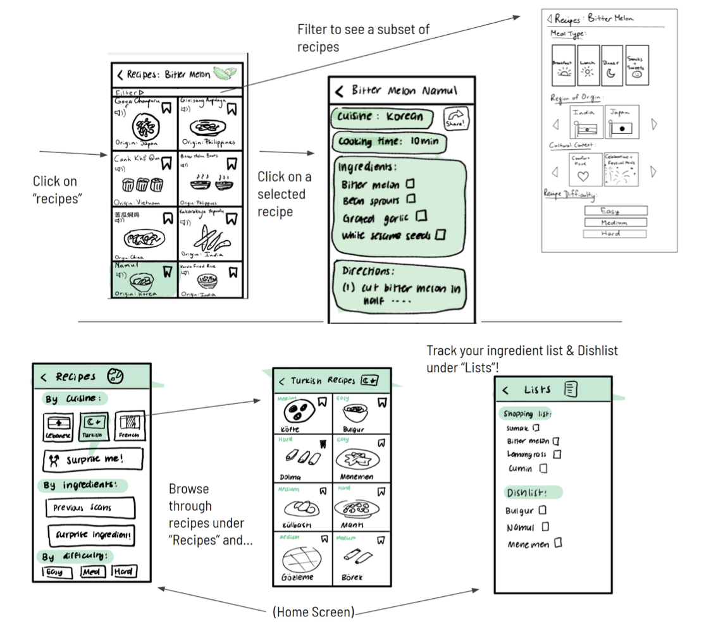
Task 3: Authentic Cooking (Low-Fi)

Slide 27
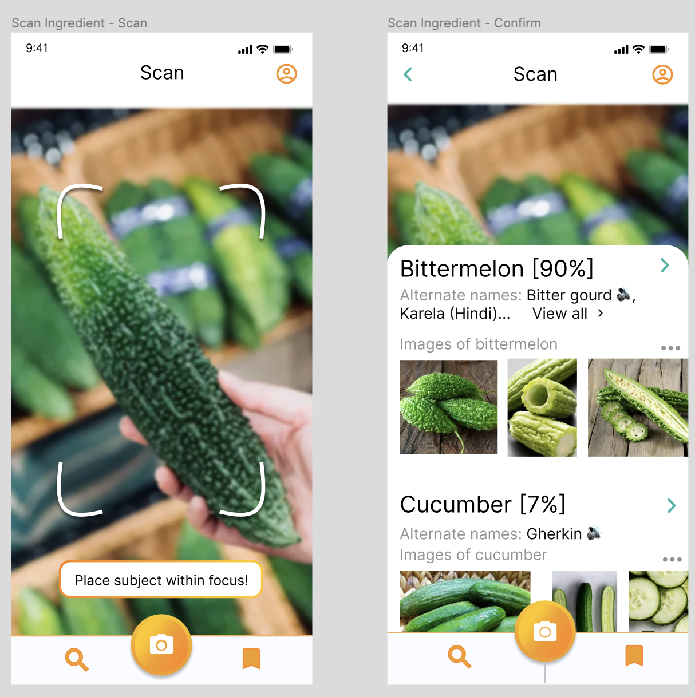
Task 1: Search for an unfamiliar food item (Med-Fi V1)

Slide 28
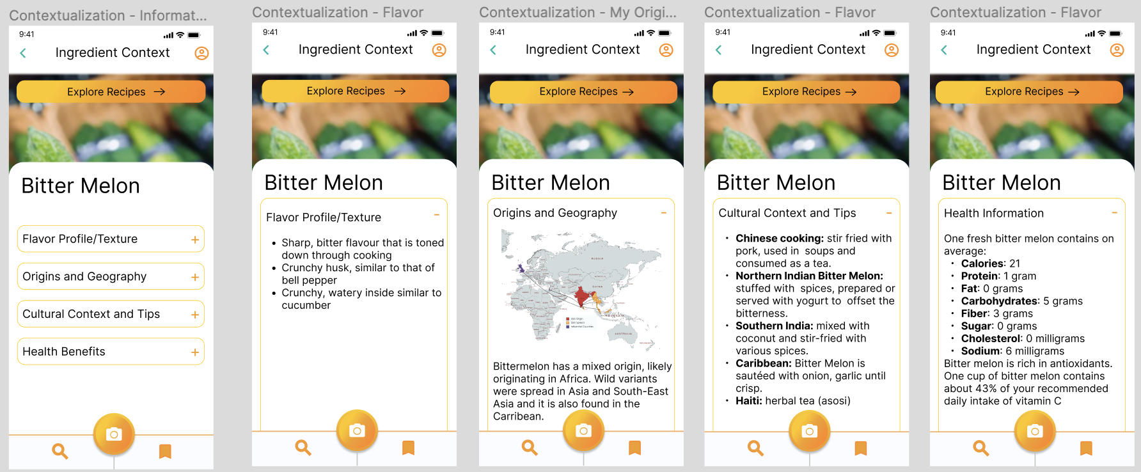
Task 2: Contextualization (Med-Fi V1)

Slide 29
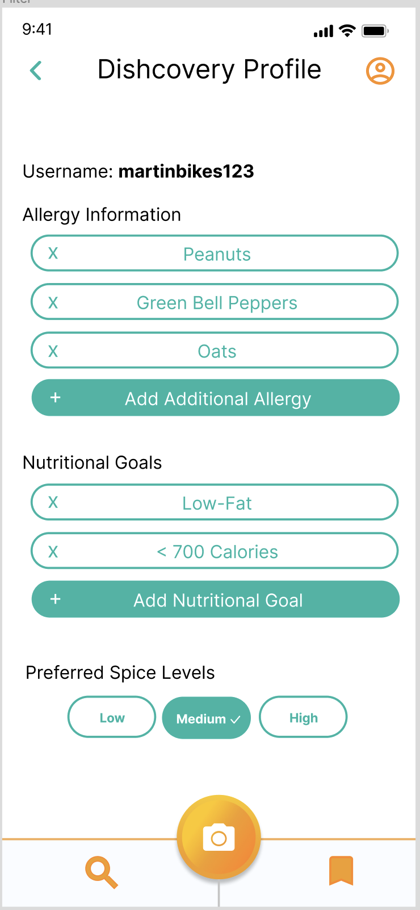
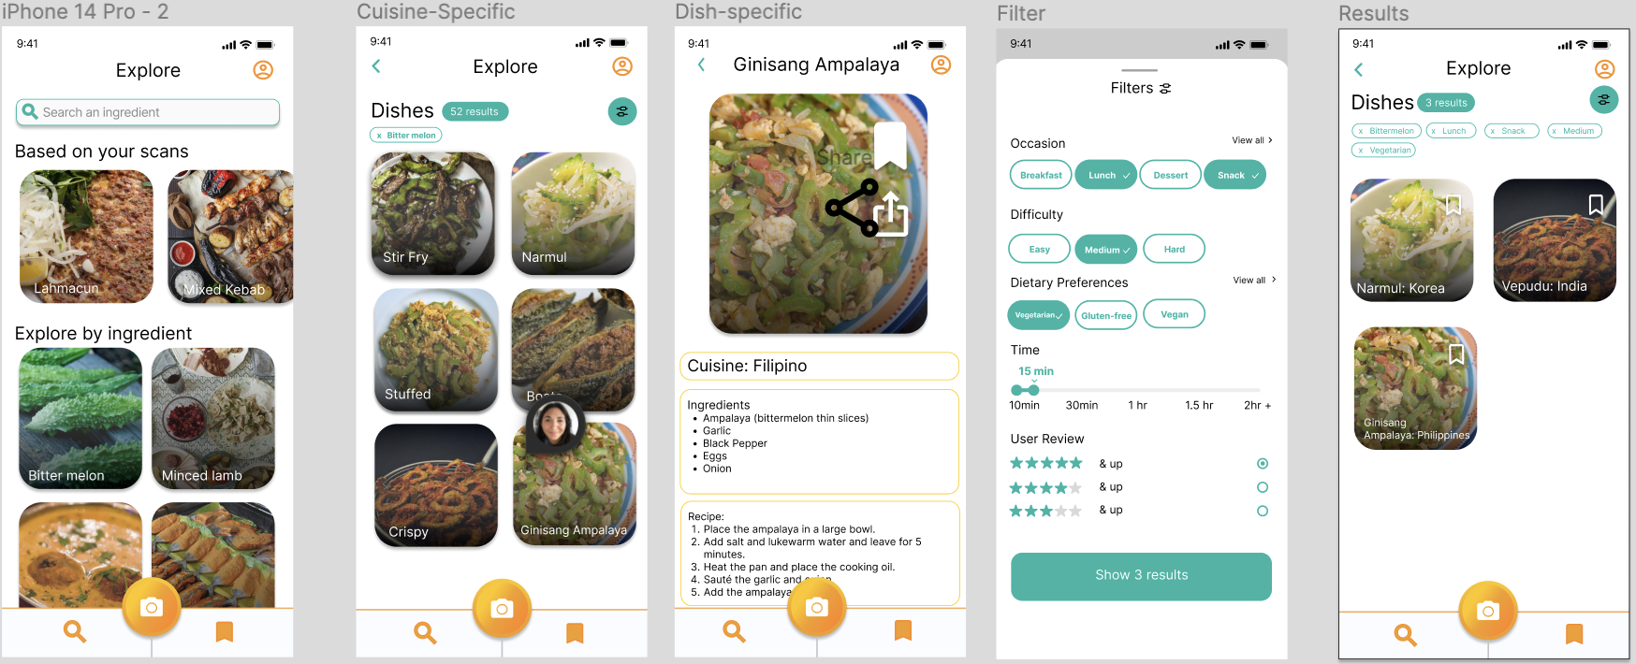
Task 3: Authentic Cooking (Med-Fi V1)

Slide 30
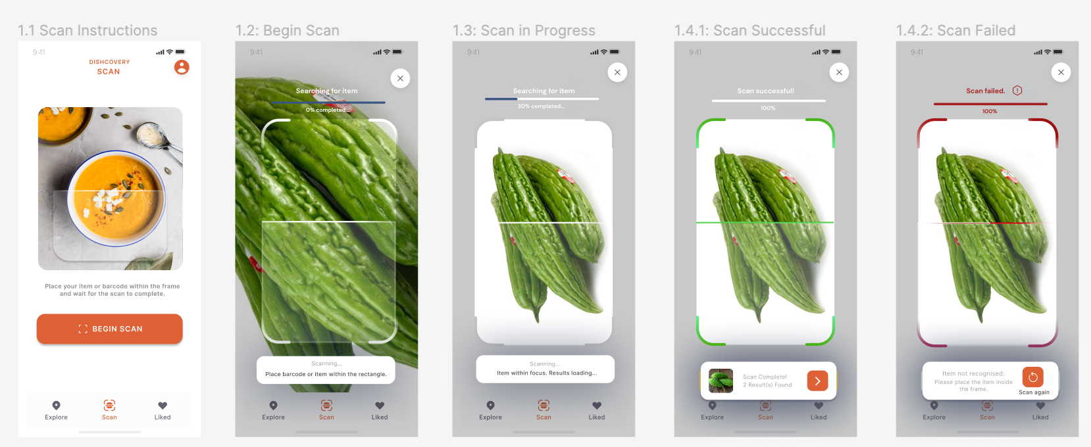
Task 1: Search for an unfamiliar food item (V2+Rationale)
S3: Removal of gradients to introduce a cleaner aesthetic.
S3: Clear instructions for placing item in focus and search in progress.
S4: Clear errors to guide user towards accurate scan results.

Slide 31
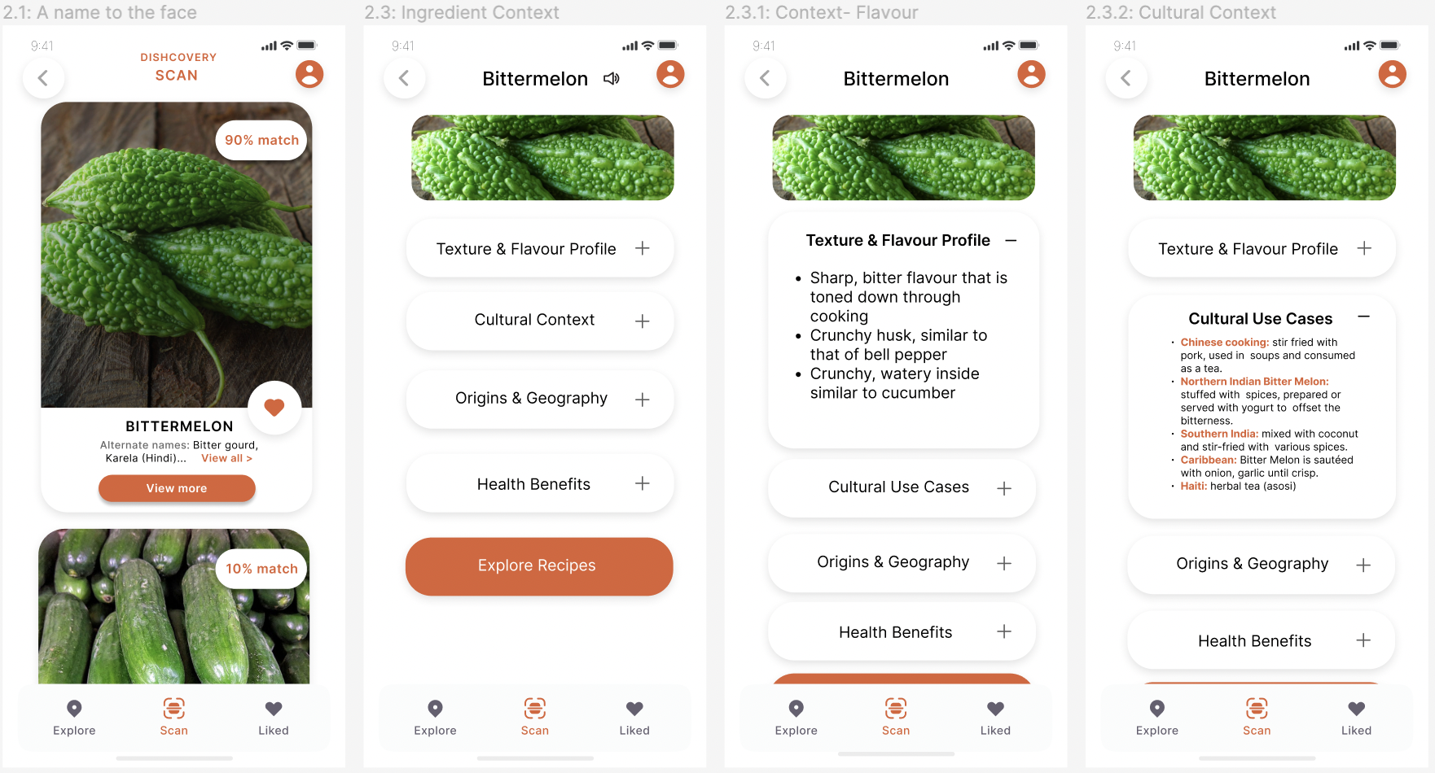
Task 2: Contextualisation (V2+Rationale)
Usability goals: increasing learnability!
S4: Added a back button.
S3: Standardized styles to improve consistency.
S4: Changed “view all” button to accent colour for improved readability.

Slide 32
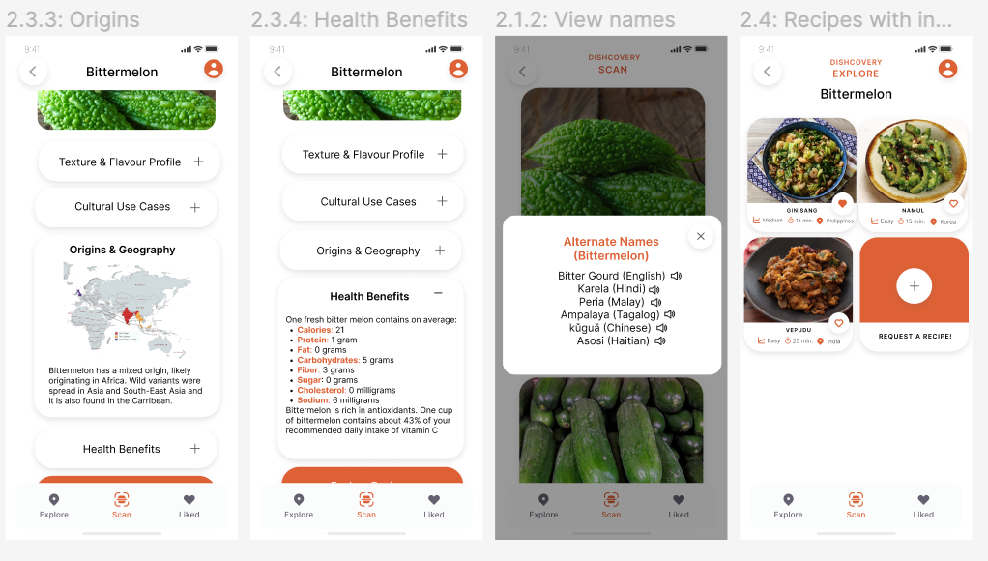
Task 2: Contextualisation (V2+Rationale)
S3: “Request recipe” option added for inclusivity
of currently under-represented cultural foods
within our app.

Slide 33
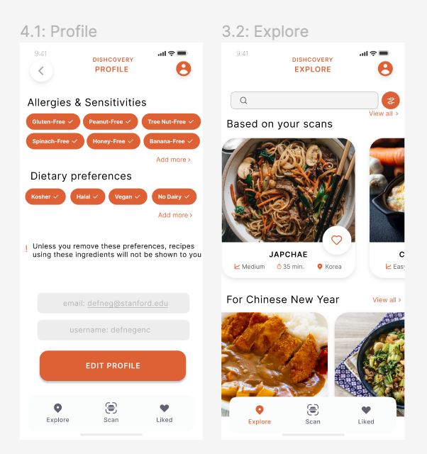
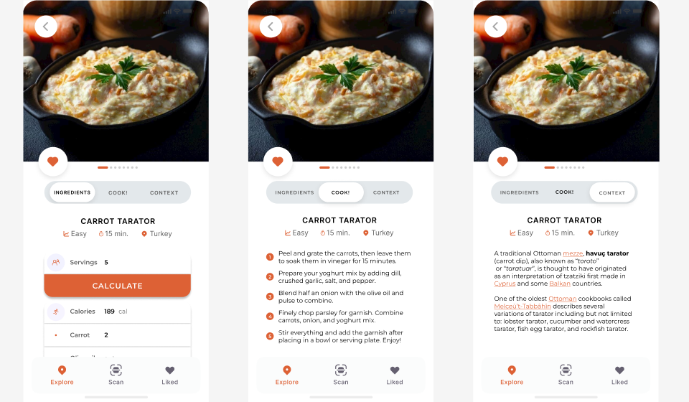
Task 3: Authentic Cooking (Med-Fi V2+Rationale)
S3: more consistent fonts and headers.
Usability goals: increasing efficiency of access to recipes!

Slide 34
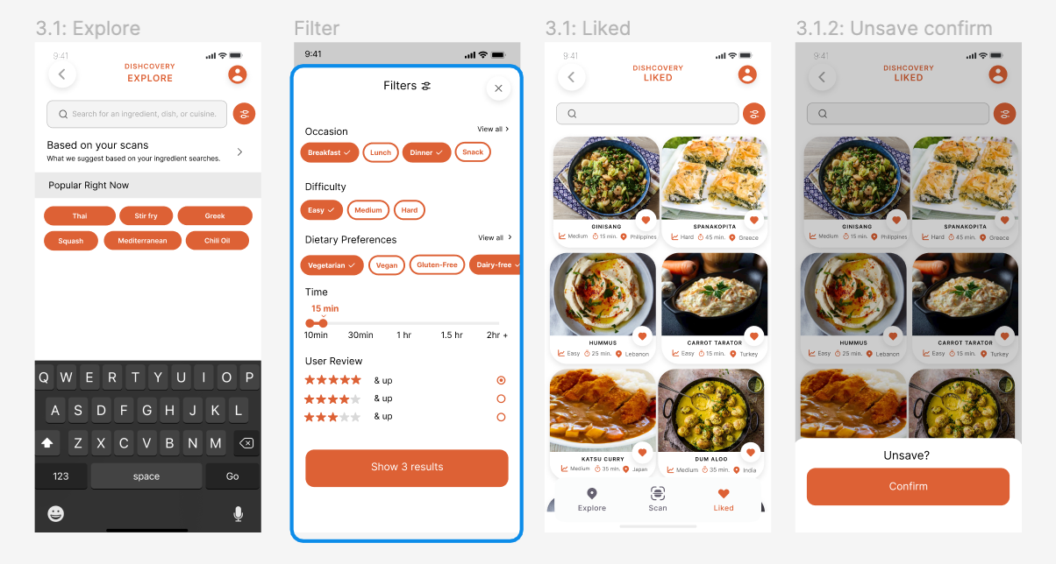
Task 3: Authentic Cooking
S3: Auto-layout for filters to improve readability
S3: Unsave confirmation added for greater visibility of status

Slide 35
Importance of Task 1: Searching for an unfamiliar food item
Uses the central functionality of the app, which we hope
would draw intrigue from users.
Generating excitement in users about this functionality will encourage them to learn more about many ingredients.
Most importantly, familiarises the users with ingredients they never thought they could use!

Slide 36
Importance of Task 2: Contextualisation
Provides a transition between our simple and medium tasks.
By learning more about the ingredient, users are encouraged to experiment with it, which was also a result affirmed by our experience prototypes.

Slide 37
Importance of Task 3: Authentic Cooking
Users get the fulfillment of enjoying a meal using a potentially intimidating ingredient.
Users obtain a new experience and add a new recipe to their arsenal, hopefully encouraging them to repeat the process with a different ingredient.

Slide 38

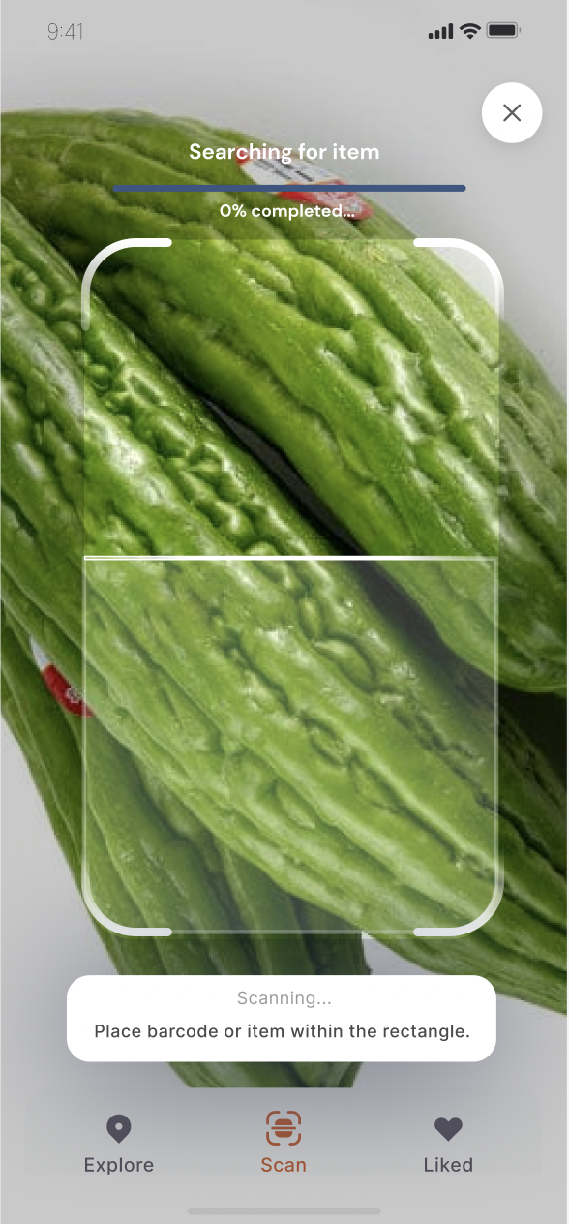
Implementation
Converting design to code

Slide 39
Framework and Tools Used for Dev
+ClarifAI API!
GitHub
VSCode
LiveShare
Expo
We have a central repo where we push updates to.
Especially when we are remote, LiveShare allows us to code collaboratively.
Expo lets us see our code changes (or code errors) come to life.
VSCode allows us to produce code files and debug errors from Expo

Slide 40
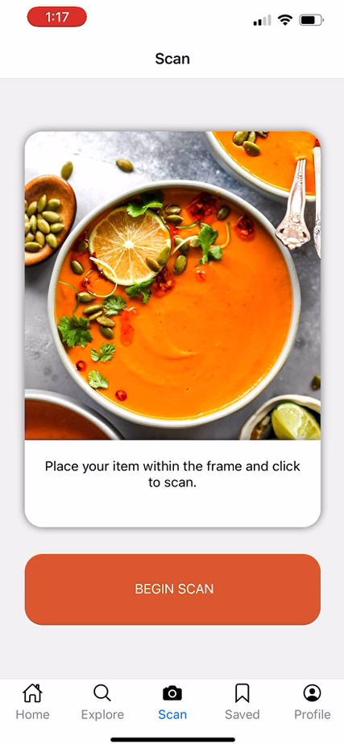
Implemented Features
Navigation for all main pages
(Tab Navigator for Home, Explore, Scan, Saved, Profile and nested Stack Navigator for Scan Flow screen)
Functionality of Task 1: Scan an Unfamiliar Ingredient has been completed
Connected to camera
Linked to Clarifai image recognition API
If ingredient is found, links to additional context page
If ingredient is not found, button to rescan
UI for Task 1: Scan an Unfamiliar Ingredient has also been completed
Animated white scanning aimer gif on top of camera
Progress bar as image recognition is searching
Scan box and progress bar turn red or green
Notes:
(in more detail in appendix)

Slide 41
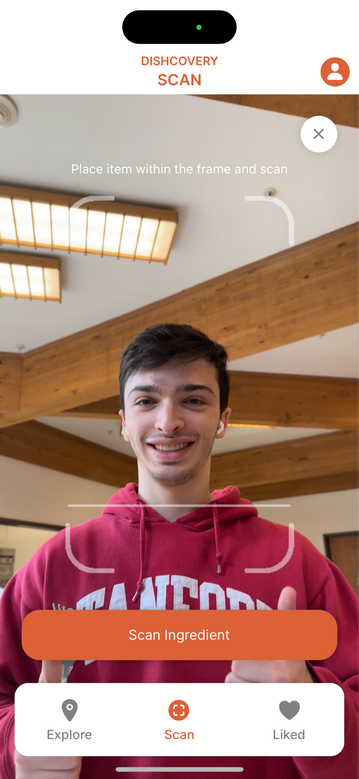
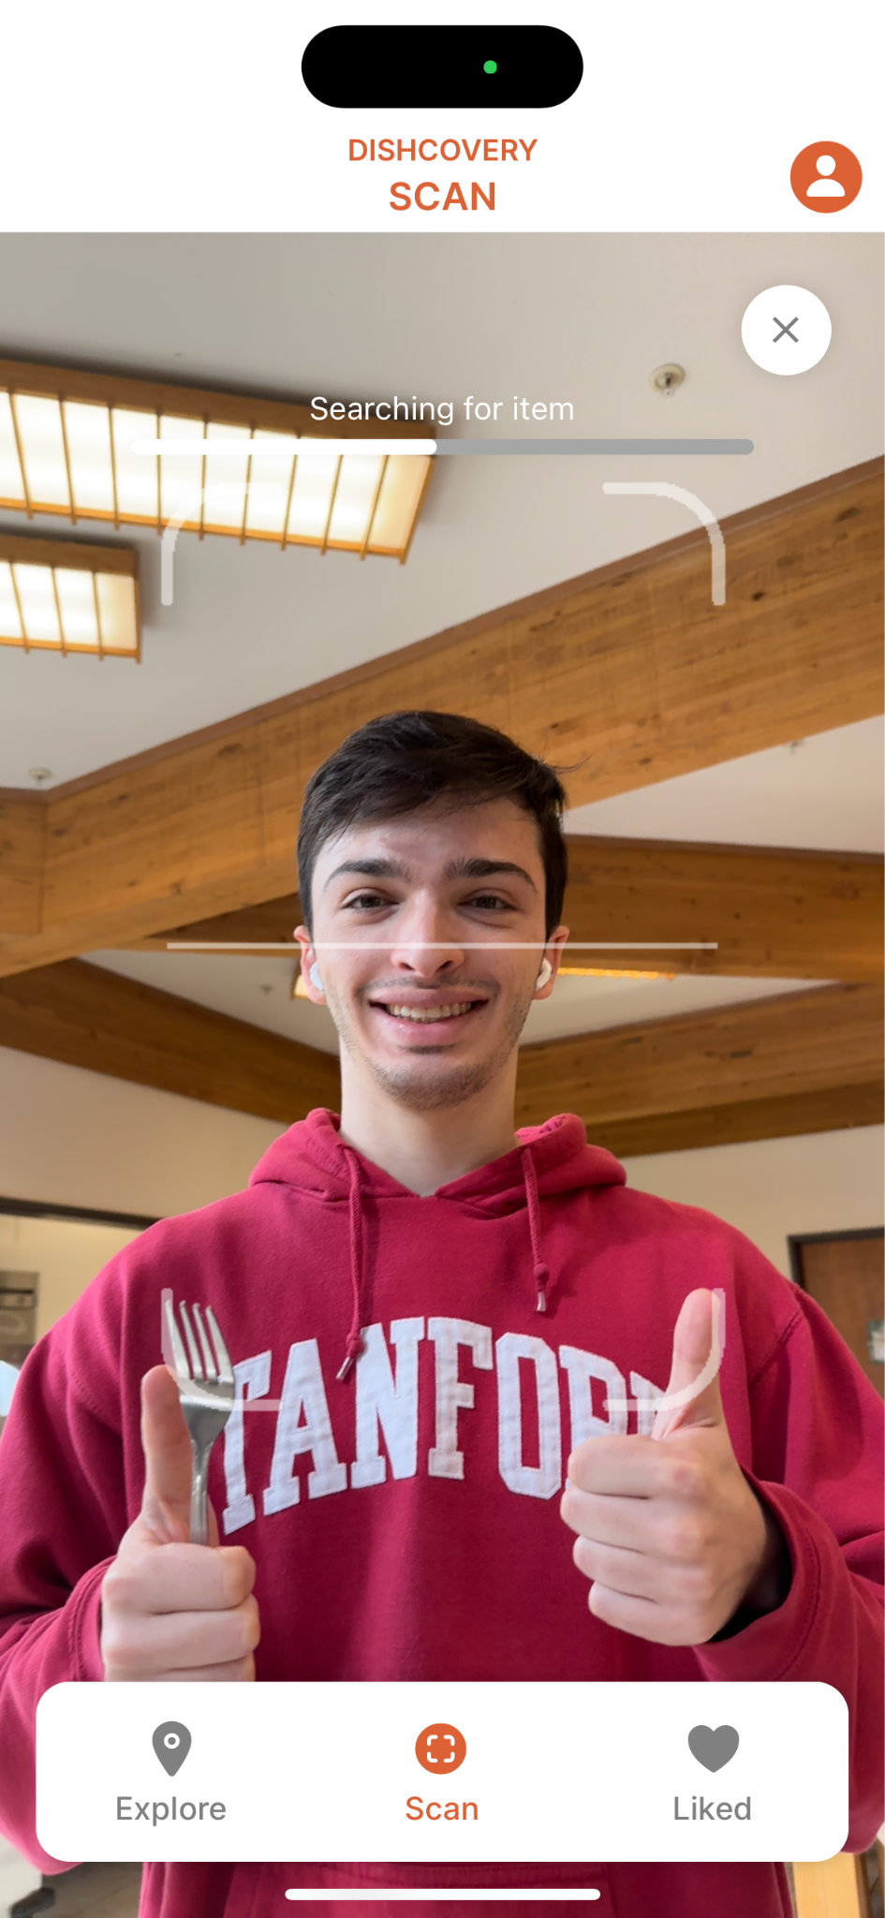
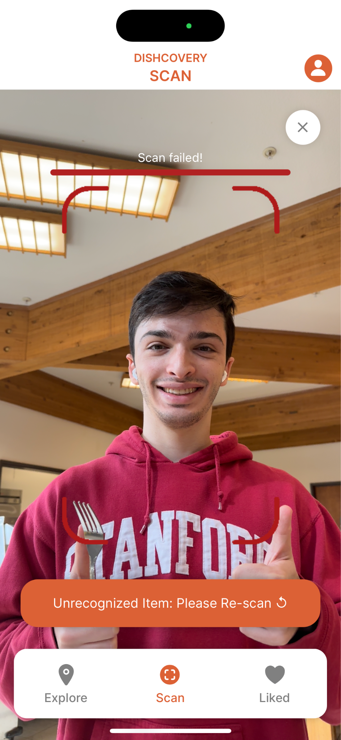

Implemented Features
*UI is slightly different to Figma because in the code you have to click to scan, and it doesn’t scan if you just hover like a QR code

Slide 42
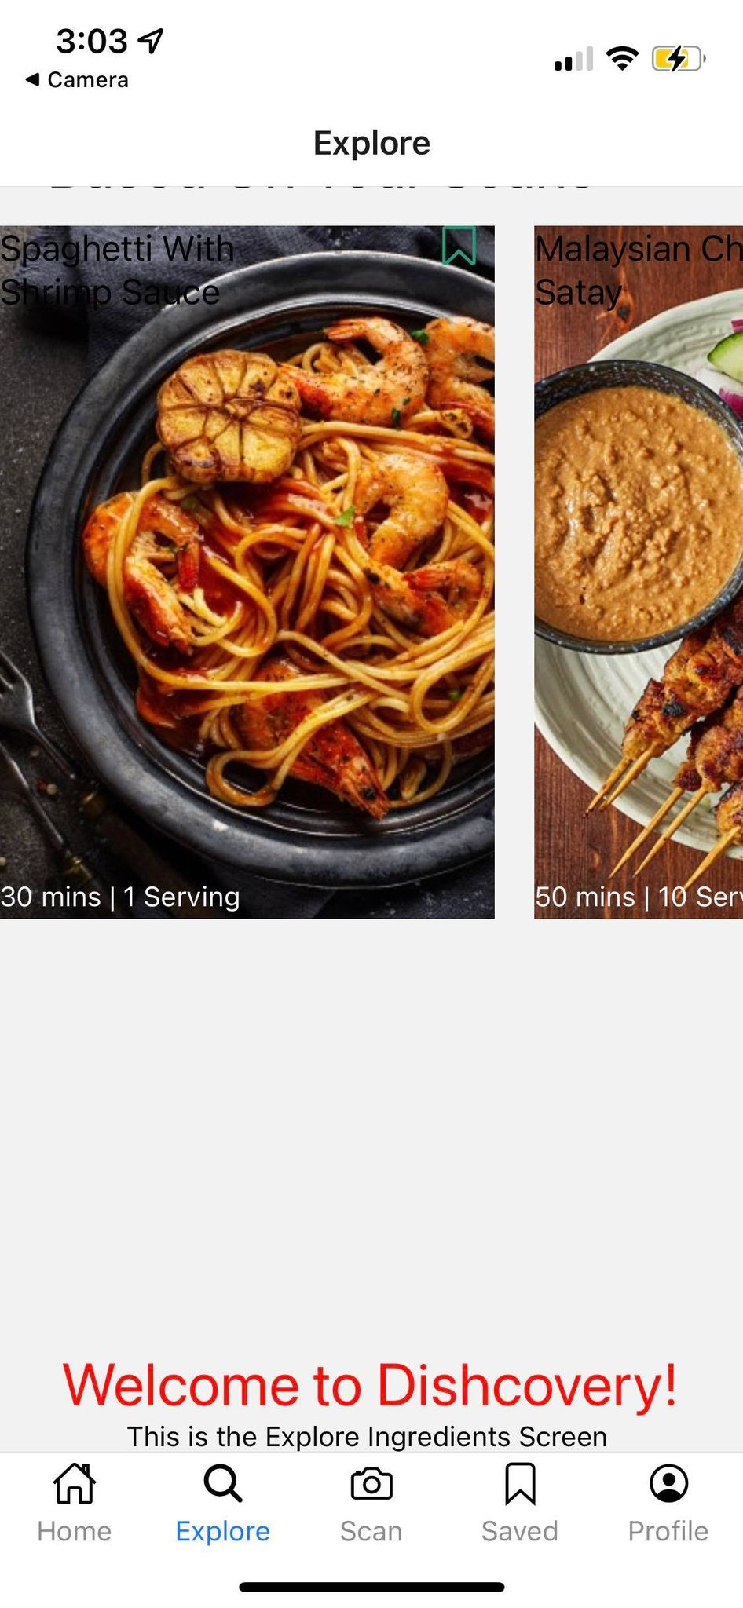
Unimplemented Features and Plans to Finish
No real database for recipes: hard-coded.
The cultural context of items is currently hard-coded and stored locally on the app.
Accuracy of image scanning is Wizard of Oz’d.
Unimplemented recipe- ‘liking’ system - currently hard-coded.
Unimplemented search feature.

Slide 43
Issues/Questions
Navigating API use:
The Clarifai AI library only recognizes fairly generic food items.
The use of this API has other limitations as we only have access to the free trial
Sourcing:
In a real app, sourcing the cultural context and making it very authentic is also a difficult and hard to scale problem if this cultural context is manually sourced.

Slide 44
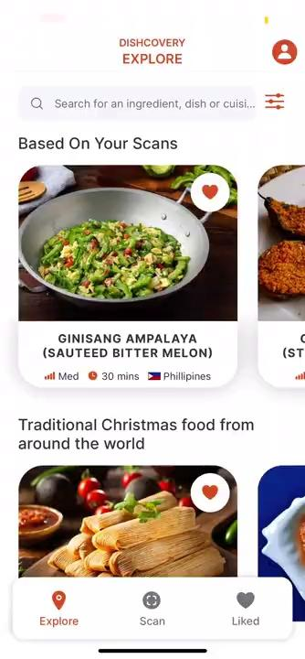
Implementation Prototype Demo
Filmed and narrated by Amrita Palaparthi!

Slide 45
What’s next?
The future of Dishcovery

Slide 46
Qualitative Enhancements
Variety of traditional dishes sourced and stored in a database to leverage in our app.
Ethically Sourced Recipes
Depicting a more representative blend of cultures including variants of any one dish.
More Accurate Labeling
Including the option for users to add a known or local recipe if not already represented.
Community-Based Features
Incorporate a common way people find food inspiration with food preparation videos.
Experimentation with Media

Slide 47
Implementation Progress
We are here!
Design
Dev pt. 1
Dev pt. 2
Test & Iterate!
Revise and prepare to code.
Code our first task flow, which is scanning.
Code up and refine the rest of our implementation, source the backend.
Until we’re confident and happy with our product.

Slide 48
Appen-dish

Slide 49
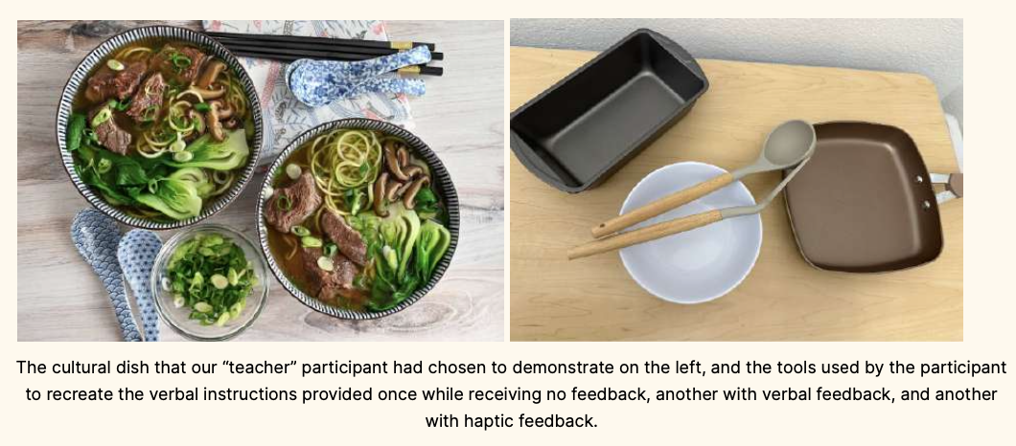
Experience prototypes

Slide 50
Progress Towards Usability Goals
Efficiency
Learnability
Increasing relevance of recipes
Scan results organization
Prototype only presents the most likely ingredient prominently.
Improved the options provided in preferences and the filtering flow. The user can also calculate ingredients required depending on serving size.
Easy access to cultural context
Guiding the user’s eyes quicker through design
Ease of use in navigating recipe with consistent fonts/coloring, added bar navigation inside the recipe itself.
The user can access cultural context of a specific ingredient after scanning, as well as the cultural context of the selected dish after recipe selection.
Notes:
More details on how we redesigned according to our heuristic evaluation

Slide 51
Addressing Heuristic Evaluation
H8 and H11: Accessible and Minimalist Design
H1: Visibility
Letting the user know the status and result of the scan.
Fewer colours and higher contrast for ease of reading.
H12: Inclusion
H7: Efficiency
More nutrition settings to be more inclusive of religious preferences.
Making all buttons fully functional.
H5: Error Prevention
H4: Consistency
Confirmations add to help users avoid mistakes.
Standardising fonts, sizes, punctuation and names.

Slide 52
Implemented Features
Navigation for all main pages (Tab Navigator for Home, Explore, Scan, Saved, Profile and nested Stack Navigator for Scan Flow screen)
Functionality of Task 1: Scan an Unfamiliar Ingredient has been completed
Connected to camera
Linked to Clarifai image recognition API
Created a library of cultural ingredients in the assets folder
Can recognize the items from the cultural ingredients (within some accuracy)
If ingredient is found, links to additional context page
If ingredient is not found, button to rescan
UI for Task 1: Scan an Unfamiliar Ingredient has also been completed
Begin Scan UI
Animated white scanning aimer gif on top of camera
Progress bar as image recognition is searching
Scan box and progress bar turn red or green if image recognition is successful or not successful
Notes:
(in more detail in appendix)

Slide 53
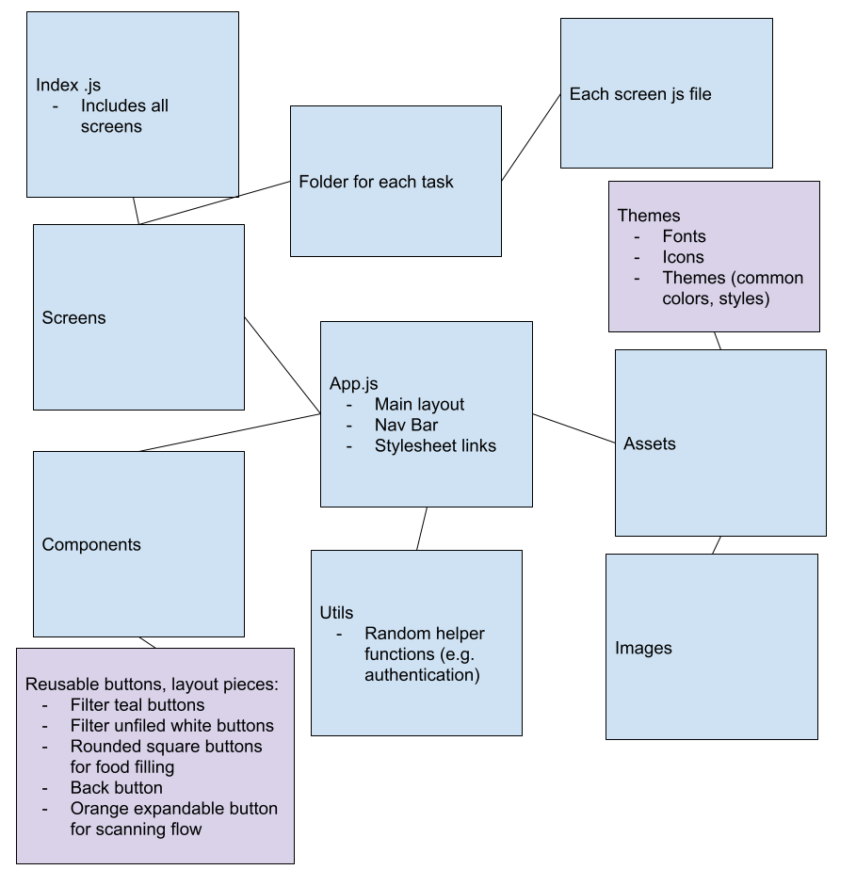
Code Organization
Assets
Fonts, icons, images styles
Constants (assets made into variables)
Fonts, icons, images, styles
Screens (organized by task flow)
HomeScreen
Scan (completed)
ScanIntroScreen
ScanScreen
ScanCompleteScreen
Additional Context Screen
Explore
SavedScreen
ProfileScreen
Components (reused in different screens)
DishCard

Slide 54
Wizard of Oz / Hard-Coded Elements
Image Recognition Accuracy
Ingredient Cultural Context
Our image recognition is actually fully functional (woohoo!).
However, the perceived accuracy is a Wizard of Oz technique as it only recognizes three ingredients from a pre-created list.
The cultural context of our selected items is currently hard-coded and stored locally on the app. In practice, this could potentially be sourced by searching the internet and interviewing individuals who prepare traditional cultural recipes.
Notes:
Image recognition only uses both the Clarifai API food-item library (around 500 generic ingredients) and our custom library of cultural food items. Currently we have three items: bitter melon, cardamom and lemongrass. So if one scanned a cucumber, it would probably come up as bitter melon.

Slide 55
Issues/Questions (more detailed)
We haven’t had significant roadblocks in our code so far but we do raise the following issues if this were to become a real app:
The Clarifai AI library only recognizes fairly generic food items. If our aim is to recognize cultural / uncommon ingredients, then using Clarifai library is actually biased against this. A specialized annotated data set of cultural ingredients and trained computer vision model would be able to truly achieve Discovery's aim. This could potentially be done by sourcing foreign food items from ethnic online grocery websites.
The use of this API has other limitations as we only have access to the free trial
In a real app, sourcing the cultural context and making it very authentic is also a difficult and hard to scale problem if this cultural context is manually sourced.

